Slide 1
Pancreaticobiliary Cancers: Highlights from Beyond PARP Inhibitors
Content of this presentation is the property of the author, licensed by ASCO. Permission required for reuse.

Slide 2
Slide 2
Content of this presentation is the property of the author, licensed by ASCO. Permission required for reuse.

Slide 3
PARP Inhibitor Mechanism of Action
Content of this presentation is the property of the author, licensed by ASCO. Permission required for reuse.

Slide 4
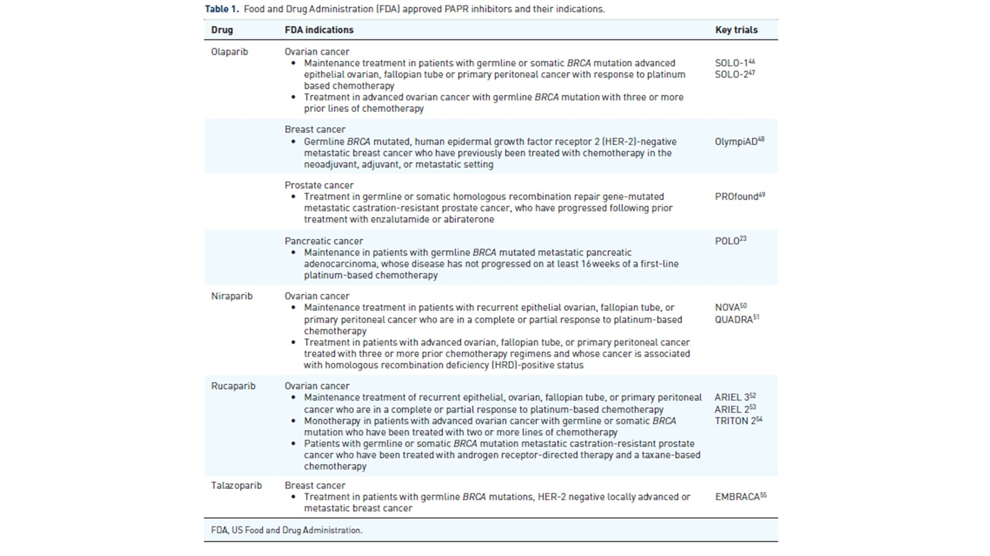
Slide 4
Content of this presentation is the property of the author, licensed by ASCO. Permission required for reuse.

Slide 5
Slide 5
Content of this presentation is the property of the author, licensed by ASCO. Permission required for reuse.

Slide 6
However, evidence shows that PARPi resistance emerges …
Content of this presentation is the property of the author, licensed by ASCO. Permission required for reuse.

Slide 7
BRCA1/2 reversion mutations as a mechanism of PARPi resistance
Content of this presentation is the property of the author, licensed by ASCO. Permission required for reuse.

Slide 8
Current and Future Potentially Promising Therapies for GI Cancers
Content of this presentation is the property of the author, licensed by ASCO. Permission required for reuse.

Slide 9
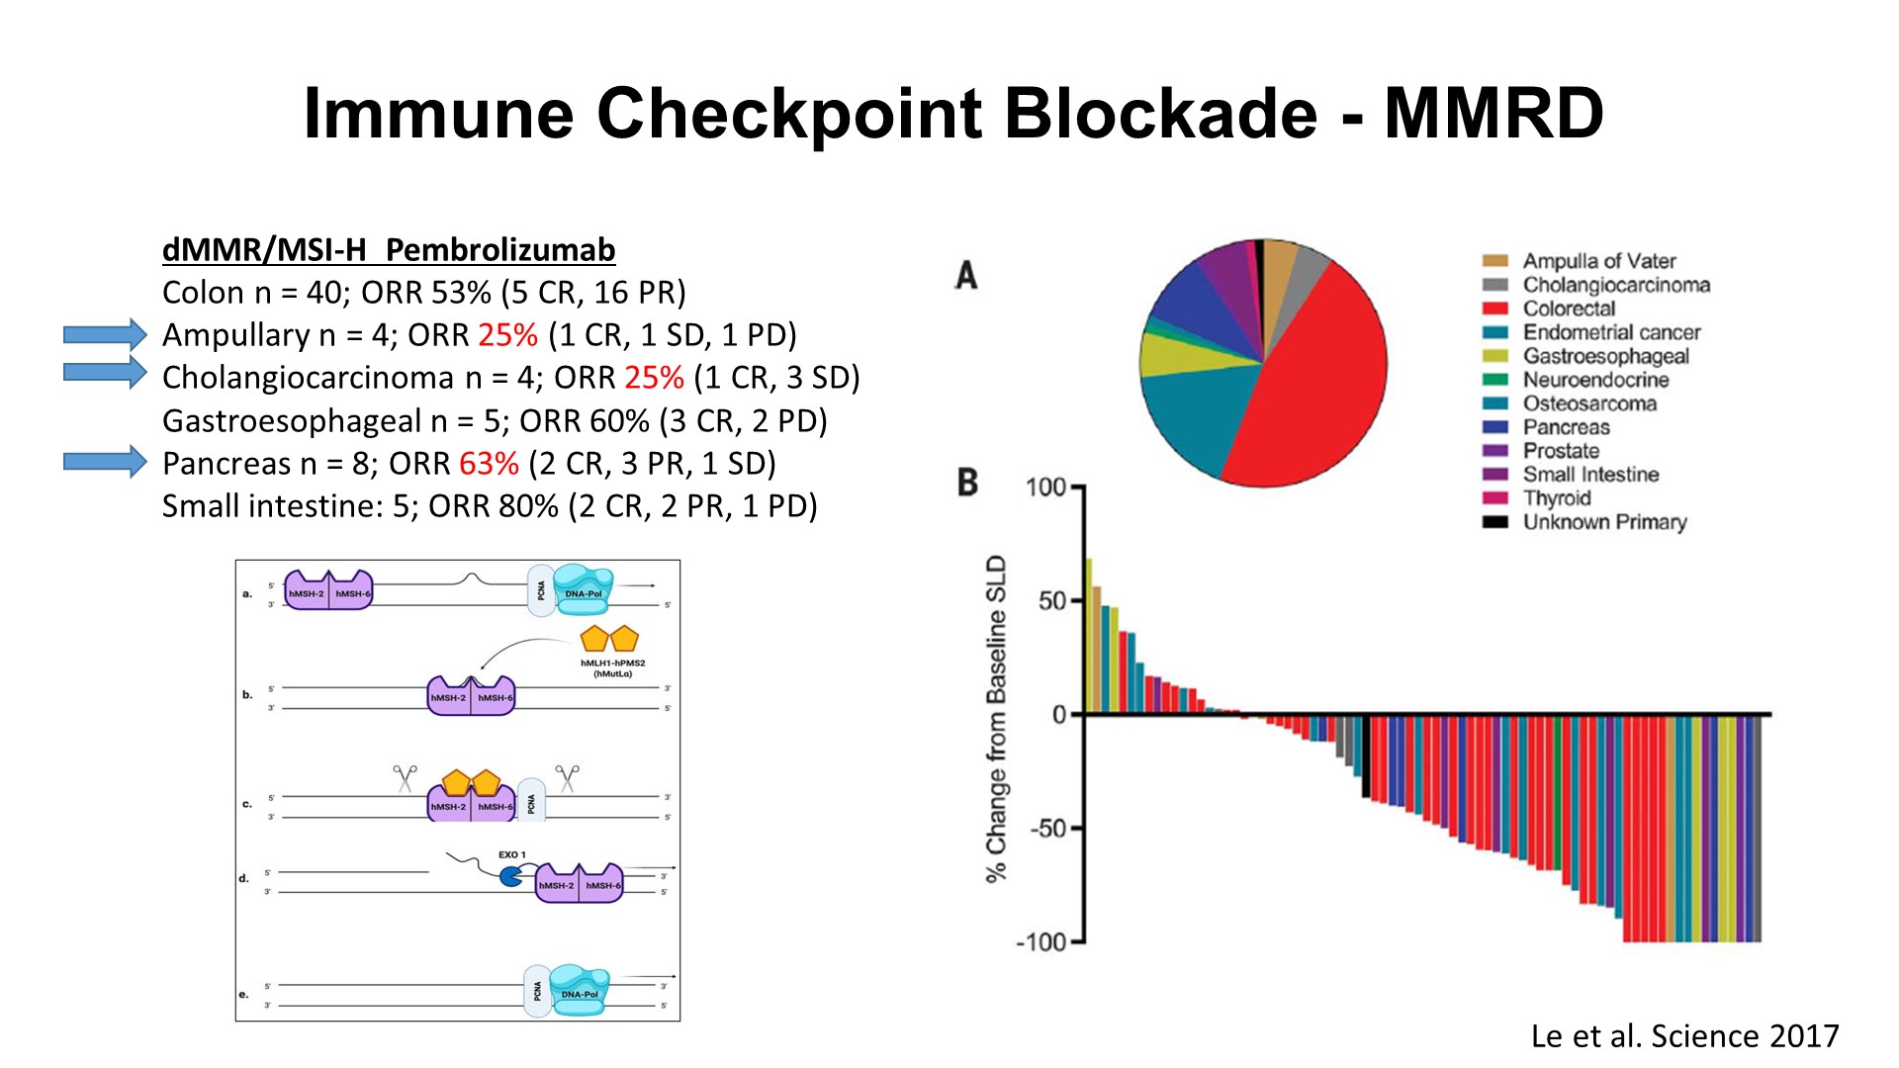
Slide 9
Content of this presentation is the property of the author, licensed by ASCO. Permission required for reuse.

Slide 10
Slide 10
Content of this presentation is the property of the author, licensed by ASCO. Permission required for reuse.

Slide 11
Anti-PD1 immunotherapy<br />Somatic BRCA2 loss associated with sensitivity to ICB
Content of this presentation is the property of the author, licensed by ASCO. Permission required for reuse.

Slide 12
Slide 12
Content of this presentation is the property of the author, licensed by ASCO. Permission required for reuse.

Slide 13
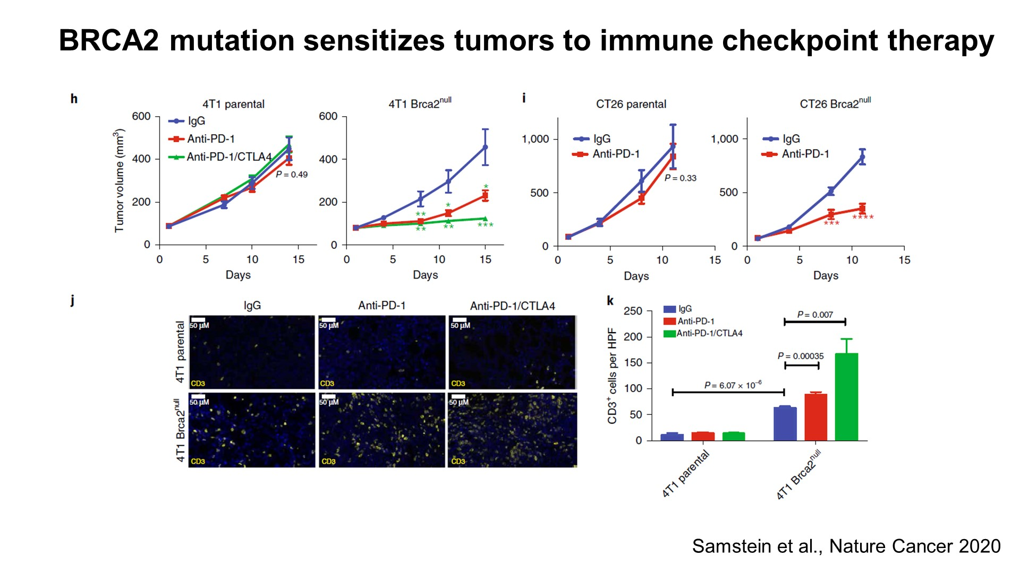
Slide 13
Content of this presentation is the property of the author, licensed by ASCO. Permission required for reuse.

Slide 14
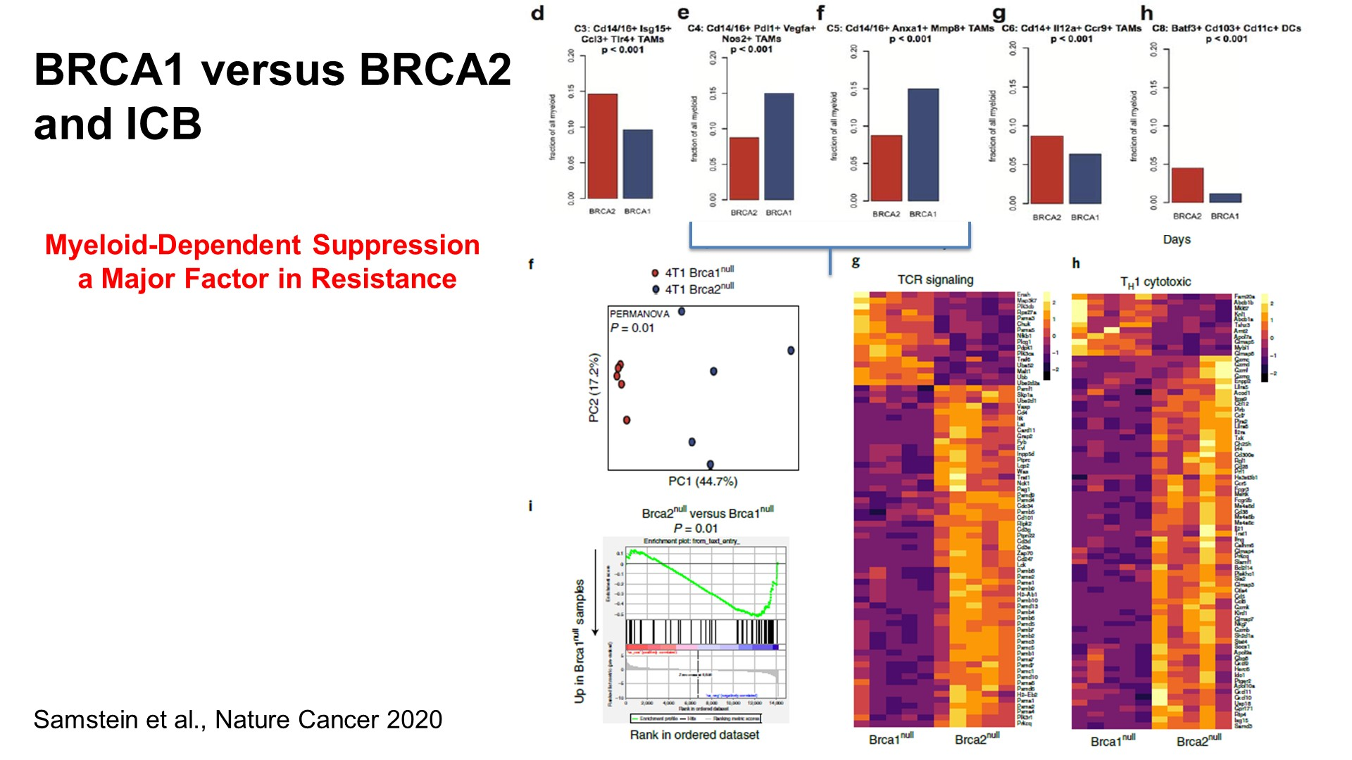
Slide 14
Content of this presentation is the property of the author, licensed by ASCO. Permission required for reuse.

Slide 15
Slide 15
Content of this presentation is the property of the author, licensed by ASCO. Permission required for reuse.

Slide 16
Slide 16
Content of this presentation is the property of the author, licensed by ASCO. Permission required for reuse.

Slide 17
Slide 17
Content of this presentation is the property of the author, licensed by ASCO. Permission required for reuse.

Slide 18
Slide 18
Content of this presentation is the property of the author, licensed by ASCO. Permission required for reuse.

Slide 19
Slide 19
Content of this presentation is the property of the author, licensed by ASCO. Permission required for reuse.

Slide 20
FGFR Inhibitor approvals for Cholangiocarcinoma
Content of this presentation is the property of the author, licensed by ASCO. Permission required for reuse.

Slide 21
IDH1 and IDH2 Mutations
Content of this presentation is the property of the author, licensed by ASCO. Permission required for reuse.

Slide 22
Mutant IDH Inhibitors: Cholangiocarcinoma
Content of this presentation is the property of the author, licensed by ASCO. Permission required for reuse.

Slide 23
Targeting IDH Mutant Induced Homologous Recombination Deficiency
Content of this presentation is the property of the author, licensed by ASCO. Permission required for reuse.

Slide 24
Summary
Content of this presentation is the property of the author, licensed by ASCO. Permission required for reuse.

Slide 25
Acknowledgements
Content of this presentation is the property of the author, licensed by ASCO. Permission required for reuse.

