Slide 1
Oral Abstract Discussion 314O: HIPECT4
LBA23: SAMCO-PRODIGE 54
Andrea Cercek, MD
Section Head, Colorectal Cancer
Co-Director Center for Young Onset Colorectal Cancer Memorial Sloan Kettering Cancer Center
New York, NY
Andrea Cercek, MD Content of this presentation is copyright and responsibility of the author. Permission is required for re-use.

Slide 2
Disclosures
Research Funding: Seagen, GSK, Inspirna
Advisory Board: Bayer, Seagen, Merck, G1 Therapeutics, GSK

Slide 3
Adjuvant hyperthermic intraperitoneal chemotherapy
in locally advanced colon cancer (HIPECT4): a
randomised, controlled, phase 3 trial.
Arjona-Sanchez, Alvaro PhD.
Consultant in Surgical Oncology, Unit of Surgery, Hospital University Reina Sofia, Cordoba, Spain. Maimonides Biomedical Research Institute, IMIBIC. Cordoba, Spain.

Slide 4
Regional Therapy for Locoregional Disease
Objective
To eradicate micrometastases in T4N0-2 colorectal cancer with HIPEC to improve loco-regional disease free survival
Assumptions
• That T4 on imaging is a “biomarker” of peritoneal carcinomatosis (suggesting that T4 tumors spread via local shedding)
• That intraperitoneal chemotherapy will be effective in eradicating these micrometastases
• That decreasing peritoneal only recurrence benefits patients
Andrea Cercek, MD
Content of this presentation is copyright and responsibility of the author. Permission is required for re-use.

Slide 5
Is T4 on preoperative imaging a predictive biomarker of peritoneal carcinomatosis?
The HIPECT4 study shows that T4 on preoperative imaging
demonstrated an accuracy of 82%
Prior literature has taught us that majority of patients that recur
from early-stage disease have synchronous extraperitoneal
recurrence
T4 is associated with a worse prognosis
Nodal disease also increases chance of peritoneal spread
Variable |  |  | Total: 184 | HIPEC group (89) | Control group (91) | p
Age (years) |  |  | 61.5±9 | 60±8 | 62±10 | 0.09
Gender female |  |  | 73 (39.7%) | 33 (37. 1%) | 40 (42. 1%) | 0.48
ECOG 0 1 2 |  |  | 137 (69%) 49 (26.6%) 8 (4.3%) | 63 (70.8%) 23 (25.8%) 3 (3.4%) | 64 (67.4%) 26 (27.4%) 5 (5.3%) | 0.78
BMI ≥30 |  |  | 41 (22.3%) | 20 (22.5%) | 21 (22. 1%) | 0.95
ASA ≥ 3 |  |  | 56 (31%) | 28 (32%) | 28 (30. 1%) | 0.53
PSS ≥1 |  |  | 40 (21.7%) | 19 (21.3%) | 21 (22. 1%) | 0.63
Localization: |  |  | 70 (38%) 8 (4.3%) 31 (16.9%) 75 (40.8%) | 35 (39.2%) 3 (3.4%) 17 (19. 1%) 34 (38.2%) | 35 (36.8%) 5 (5.3%) 14 (14.7%) 41 (43.2%) | 0.53
• • • • | Right colon Transverse Colon Left colon Sigmoid-rectum
Preop CEA (ng/ml) |  |  | 17.7±49.2 | 13±41 | 22±56 | 0.04
Preop Ca 19.9 (UI/ml) |  |  | 26±56 | 21±37 | 30 ±69 | 0.08
T-Stage • • • • • |  | T1-2 T3a T3b T4a T4b | 5 (2.7%) 18 (9.8%) 35 (19. 1%) 77 (42. 1%) 48 (26.2%) | 0 (0%) 9 (10. 1%) 17 (19. 1%) 36 (40.4%) 27 (30.3%) | 5 ( 5.4%) 9 ( 9.6%) 18 (19. 1%) 41 (42. 1%) 21 (22.3%) | 0.27
N-Stage • • • |  | N0 N1 N2 | 97 (53.3%) 43 (23.6%) 42 (23. 1%) | 45 (51. 1%) 23 (26. 1%) 20 (22.7%) | 52 (55.3%) 20 (21.3%) 22 (23.4%) | 0.73
Andrea Cercek, MD.
Koniski, JNCI 2019
Mayanagi DCR 2018
Content of this presentation is copyright and responsibility of the author. Permission is required for re-use.

Slide 6
Does intraperitoneal chemotherapy decrease peritoneal carcinomatosis?
PRODIGE 7, a large randomized controlled trial, demonstrated NO benefit of IP oxaliplatin over
cytoreductive surgery alone in resected metastatic colorectal cancer
Prior “adjuvant” HIPEC trails have not shown improved outcomes
Review of historical trials demonstrates that in metastatic disease the benefit is from completion of CRS and low volume disease; no clear benefit of IP chemotherapy
Bastianen VP, BMC Cancer 2019
Klaver C, BMC Cancer 2015
Elias. J Clin Oncol 2010

Slide 7
Regional Therapy for Locoregional Disease
Objective
To eradicate micrometastases in T4N0-2 colorectal cancer with HIPEC to improve loco-regional disease free survival
Assumptions
• That T4 on imaging is a “biomarker” of peritoneal carcinomatosis (suggesting that T4 tumors spread via local shedding) No
• That intraperitoneal chemotherapy will be effective in eradicating these micrometastases No
• That decreasing peritoneal only recurrence benefits patients
Andrea Cercek, MD
Content of this presentation is copyright and responsibility of the author. Permission is required for re-use.

Slide 8
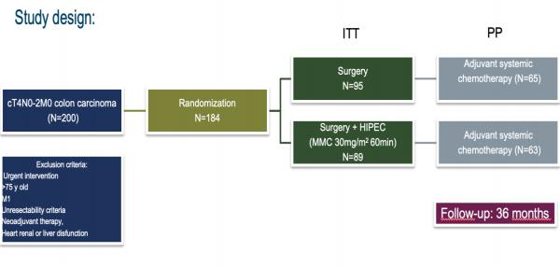
HIPECT4: Phase 3 randomized control trial
1 in 5 patients did not receive adjuvant chemotherapy
Type of chemotherapy is not described
T4N0-2 is considered high risk and the current recommendation is 5FU + oxaliplatin based chemotherapy
Primary end-point: loco regional control (LC) disease at 3 years
Secondary end-points: safety, DFS and OS
Centres included: 17 belonging to Spanish Group of Peritoneal Oncologic Surgery (GECOP).

Slide 9
HIPECT4: Patient characteristics
Well balanced patients:
T4a/b status
N status
Tumor sidedness
RAS/RAF status
Preoperative CEA higher in control group
Variable |  |  | Total: 184 | HIPEC group (89) | Control group (91) | p
Age (years) |  |  | 61.5±9 | 60±8 | 62±10 | 0.09
Gender female |  |  | 73 (39.7%) | 33 (37. 1%) | 40 (42. 1%) | 0.48
ECOG 0 1 2 |  |  | 137 (69%) 49 (26.6%) 8 (4.3%) | 63 (70.8%) 23 (25.8%) 3 (3.4%) | 64 (67.4%) 26 (27.4%) 5 (5.3%) | 0.78
BMI ≥30 |  |  | 41 (22.3%) | 20 (22.5%) | 21 (22. 1%) | 0.95
ASA ≥ 3 |  |  | 56 (31%) | 28 (32%) | 28 (30. 1%) | 0.53
PSS ≥1 |  |  | 40 (21.7%) | 19 (21.3%) | 21 (22. 1%) | 0.63
Localization: |  |  | 70 (38%) 8 (4.3%) 31 (16.9%) 75 (40.8%) | 35 (39.2%) 3 (3.4%) 17 (19. 1%) 34 (38.2%) | 35 (36.8%) 5 (5.3%) 14 (14.7%) 41 (43.2%) | 0.53
• • • • | Right colon Transverse Colon Left colon Sigmoid- rectum
Preop CEA (ng/ml) |  |  | 17.7±49.2 | 13±41 | 22±56 | 0.04
Preop Ca 19.9 (UI/ml) |  |  | 26±56 | 21±37 | 30 ±69 | 0.08
T-Stage • • • • • |  | T1-2 T3a T3b T4a T4b | 5 (2.7%) 18 (9.8%) 35 (19. 1%) 77 (42. 1%) 48 (26.2%) | 0 (0%) 9 (10. 1%) 17 (19. 1%) 36 (40.4%) 27 (30.3%) | 5 ( 5.4%) 9 ( 9.6%) 18 (19. 1%) 41 (42. 1%) 21 (22.3%) | 0.27
N-Stage • • • |  | N0 N1 N2 | 97 (53.3%) 43 (23.6%) 42 (23. 1%) | 45 (51. 1%) 23 (26. 1%) 20 (22.7%) | 52 (55.3%) 20 (21.3%) 22 (23.4%) | 0.73
Variable |  | Total: 184 | HIPEC group (89) | Control group (91) | p
Low Grade Differentiation |  | 119 (66.9%) | 58 (65.9%) | 61 (67.8%) | 0.88
Type of adenocarcinoma |  | 32 (17.5%) 3 (1.6%) | 15 (16.9%) 2 (2.2%) | 17 (18. 1%) 1 (1. 1%) | 0.70
• • | Mucinou s Signet ring
Tumour size (cm) |  | 6.9±3.8 | 6.5±3.2 | 7.2±4.4 | 0.11
Braf- mutation* |  | 8 (22.8%) | 4 (23.5%) | 4 (22%) | 0.96
K-RAS wild type^ |  | 26 (61%) | 11 (50%) | 15 (75%) | 0.17
Lymph nodes isolated |  | 25±12 | 25±12 | 26±12 | 0.89
Blood needed |  | 23 (12.4%) | 15 (16.9%) | 8 (8.3%) | 0,08
Laparoscopic approach |  | 29 (15.8%) | 17 (19. 1%) | 12 (12.6%) | 0.22
Operative time (min) |  | 250±97 | 311±82 | 193±73 | 0.47
Ostomy |  | 12 (6.5%) | 4 (4.4%) | 8 (8.4%) | 0.24
Intraoperative vasoactive drugs |  | 10 (5,4%) | 7 (7.9%) | 3 (3. 1%) | 0.15
Adjuvant therapy |  | 128 (82%) | 63 (84.2%) | 65 (78.9%) | 0.52
Arjona-Sanchez Alvaro
Content of this presentation is copyright and responsibility of the author. Permission is required for re-use.

Slide 10
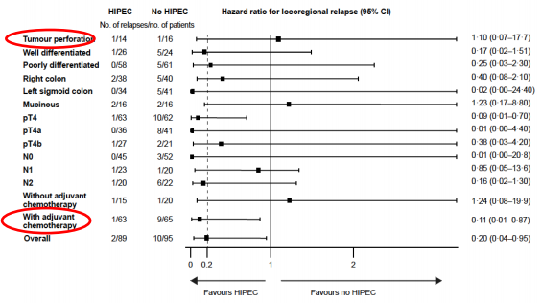
HIPECT4: Results
Analyses are difficult to interpret:
• Tumor Perforation favors NO HIPEC
• Adjuvant chemotherapy associated with increased peritoneal recurrence
• N0 and N2 both favor HIPEC while N1 does not

Slide 11
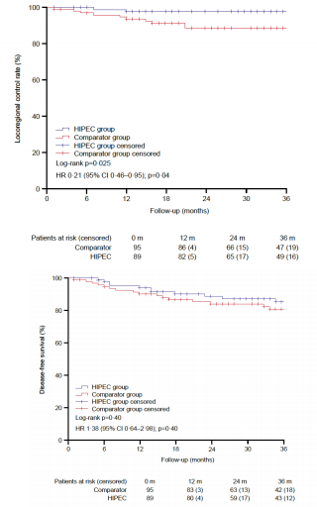
HIPECT4: Results
Extraperitoneal recurrences were common
Loco-regional DFS did not result in improved overall DFS or OS
Unclear if patients who had extraperitoneal disease did not develop peritoneal disease due to chemotherapy

Slide 12
HIPECT4: Morbidity
Variable | Total: 184 | HIPEC group (89) | Control group (95) | p
Ostomy | 12 (6,6%) | 4 (4,5%) | 8 (8,5%) | 0.24
Anaemia (CTCAE) Grade 1 Grade 2 Grade 3 | 25 (13.7%) 26 (14.3%) 12 (6 6%) | 13 (14.8%) 14 (16%) 7 (8%) | 12 (12.8%) 12 (12.8%) 5 (5 3%) | 0.71
Neutropenia (CTCAE) Grade 1 Grade 2 Grade 3 Grade 4 | 4 (2.2%) 4 (2.2%) 1 (0.5%) 1 (0 5%) | 2 (2.2%) 4 (4.5%) 1 (1. 1%) 1 (1 1%) | 2 (2.2%) 0 0 0 | 0.14
Thrombocytopenia (CTCAE) Grade 1 Grade 2 | 3 (2.2%) 2 (1. 1%) | 2 (2.3%) 2 (2.3%) | 1 (1. 1%) 0 | 0.27
Renal Failure (RIFLE) R I | 2 (1. 1%) 1 (0.5%) | 1 (1. 1%) 1 (1. 1%) | 1 (1. 1%) 0 | 0.54
Re-intervention | 22 (11,7%) | 11 (12%) | 11 (11%) | 0.89
Major morbidity 30 days | 38 (20.8%) | 21 (23.6%) | 17 (18. 1%) | 0.35
Major morbidity 90 days | 40 (21,9%) | 23 (25.8%) | 17 (18. 1%) | 0.20
Mortality 30 days | 3 (1.6%) | 1 (1. 1%) | 2 (2. 1%) | 0.60
Major morbidity was high in both groups, possibly led to low rates of systemic chemotherapy
No significant difference in morbidity in HIPEC group
Long term effects such as increased adhesions are unknown
Widmar, DCR 2020
Content of this presentation is copyright and responsibility of the author. Permission is required for re-use.
Andrea Cercek, MD

Slide 13
Regional Therapy for Locoregional Disease
Objective
To eradicate micrometastases in T4N0-2 colorectal cancer with HIPEC to improve loco-regional disease free survival
Assumptions
• That T4 on imaging is a “biomarker” of peritoneal carcinomatosis (suggesting that T4 tumors spread via local shedding) No
• That intraperitoneal chemotherapy will be effective in eradicating these micrometastases No
• That decreasing peritoneal only recurrence benefits patients No
Andrea Cercek, MD
Content of this presentation is copyright and responsibility of the author. Permission is required for re-use.

Slide 14
Regional Therapy for Locoregional Disease
Authors Conclusion:
The use of HIPEC with mitomycin C with complete cytoreductive surgery in locally advanced colorectal cancer improves the loco regional control rate without increasing morbidity. This clinical benefit is greatest in the definitive pT4 sub-population.
My Conclusion:
Although adjuvant HIPEC appeares to improve locoregional control in this trial
• T4 is an inadequate ”biomarker” of peritoneal carcinomatosis
• T4 is associated with systemic disease as demonstrated by lack of DFS and OS benefit
• T4 disease should be treated with systemic therapy
Andrea Cercek, MD
Content of this presentation is copyright and responsibility of the author. Permission is required for re-use.

Slide 15
LBA 23:
Avelumab versus standard second-line treatment in MSI metastatic colorectal
cancer patients : the SAMCO-PRODIGE 54
randomised phase II trial.
Julien TAIEB, Olivier BOUCHE, Thierry ANDRE, Emilie BARBIER, Pierre LAURENT-PUIG, Jérémie BEZ, Clémence TOULLEC, Christophe BORG, Violaine RANDRIAN, Ludovic EVESQUE,
Stephane CORBINAIS, Hervé PERRIER, Bruno BUECHER, Frederic DI
FIORE, Claire Gallois, Come LEPAGE, Farid ELHAJBI, David
TOUGERON.
Julien TAIEB
Paris, France, September 11, 2022

Slide 16
Study Design: SAMCO-PRODIGE 54
• metastatic CRC • Received only one prior regimen of cytotoxic chemotherapy +/- targeted therapy for metastatic disease • ECOG PS 0- 1 • MSI-H and dMMR
P D
Avelumab 10mg/kg/2W
R
1:1
Standard 2nd line treatment*
Primary endpoint • PFS INV-assessed key secondary endpoints • OS • ORR • DOR • Tolerability
*FOLFOX or FOLFIRI depending on 1st line regimen
+/- targeted agent
(bevacizumab, aflibercept,
ramucirumab, panitumumab,
cetuximab)
Stratification factors • Age (> or<70) • ECOG (0 vs 1) • BRAF (mut vs wt)
Andrea Cercek, MD
Content of this presentation is copyright and responsibility of the author. Permission is required for re-use.

Slide 17
Study Design: SAMCO-PRODIGE 54
MSI-H/dMMR mCRC First line chemotherapy
P D
Avelumab (PD-L1)
R
1:1
2nd line chemotherapy*
Primary endpoint • PFS
A randomized study in second line of immunotherapy vs chemotherapy in immunotherapy naïve MSI mCRC
Andrea Cercek, MD
Content of this presentation is copyright and responsibility of the author. Permission is required for re-use.

Slide 18
Immune-checkpoint inhibitors in dMMR/MSI mCRC
Established in first line and beyond in US and Europe
• Immunotherapy is active in dMMR/MSI mCRC
• SAMCO-PRODIGE 54 demonstrated activity in second line
• It raises interesting caveats
https://www.nccn.org/professionals/drug_compendium/content/
https://www.ema.europa.eu/en/documents/rmp-summary/keytruda-epar-risk-management-plan-summary_en.pdf https://www.ema.europa.eu/en/documents/product-information/opdivo-epar-product-information_en.pdf

Slide 19
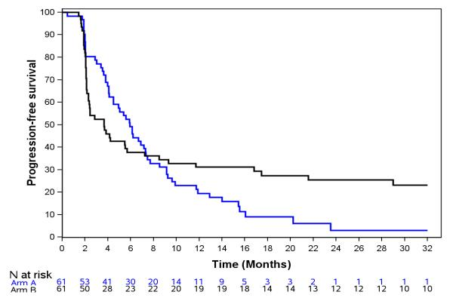
Results: Progression Free Survival
Chemotherapy ± targeted therapy
The study met is primary endpoint of PFS
Avelumab
p= 0.025
Median
Follow-up:
33.3 months
(28.3-34.8)
25%
3%
31% 19% | 27% 9%
Andrea Cercek, MD
Content of this presentation is copyright and responsibility of the author. Permission is required for re-use.

Slide 20
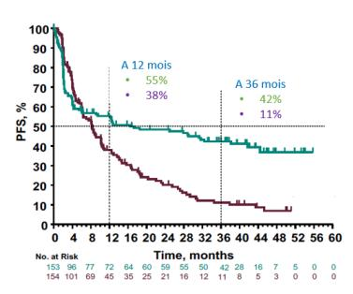
Results
PRODIGE 54-SAMCO
2nd-line Avelumab
KEYNOTE 177
First line Pembrolizumab
 | 31% 19% | 27% 9% | 25% 3%
Andrea Cercek, MD
Content of this presentation is copyright and responsibility of the author. Permission is required for re-use.

Slide 21
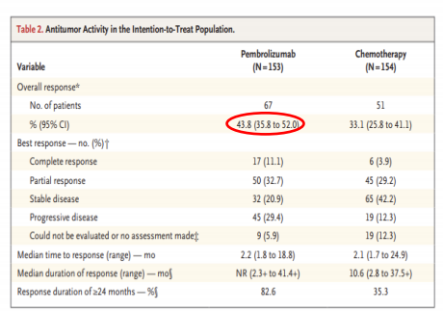
Results
Second line: avelumab SAMCO-PRODIGE54
First line: pembrolizumab Keynote 177
Avelumab N = 61 |  | Chemotherapy N = 61
Complete response | 4 (6 5%) | 3 (5%)
Partial response | 14 (23%) | 13 (21 3%)
ORR | 18 (29 5%) | 16 (26 3%)
Stable disease | 25 (41%) | 31 (51%)
DCR | 43 (70.5%) | 47 (77.3%)
Progressive disease | 17 (28%) | 10 (16.5%)
Time to best response (months) | 2.99 | 1.94
Andre, NEJM 2020
Content of this presentation is copyright and responsibility of the author. Permission is required for re-use.
Andrea Cercek, MD

Slide 22
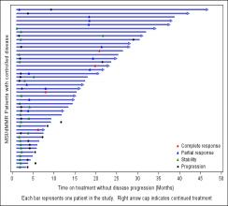
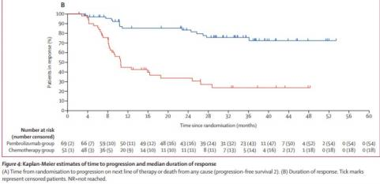
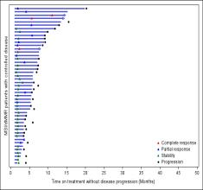
Response are durable
Second line: avelumab SAMCO-PRODIGE54
First line: pembrolizumab Keynote 177
Avalumab
Chemotherapy +/- targeted agent
Diaz LA, Lancet Oncology 2021
Content of this presentation is copyright and responsibility of the author. Permission is required for re-use.

Slide 23
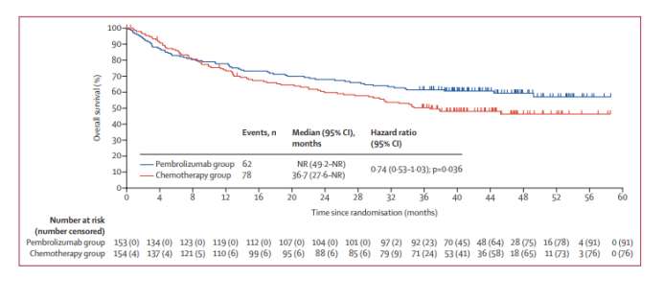
Early treatment is better
Keynote 177 Overall Survival
Diaz LA, Lancet Oncology 2021
Content of this presentation is copyright and responsibility of the author. Permission is required for re-use.

Slide 24
My conclusions:
Second line PD-L1 blockade is active in dMMR/MSI mCRC not previously treated with immunotherapy
Early treatment results in better efficacy and is preferred
All lines lead to durable responses
Unanswered questions:
Why do a proportion of dMMR/MSI mCRC tumors exhibit resistance to immune-checkpoint inhibitors?
Andrea Cercek, MD
Content of this presentation is copyright and responsibility of the author. Permission is required for re-use.

Slide 25
European Society for Medical Oncology (ESMO)
Via Ginevra 4, CH-6900 Lugano
T. +41 (0)91 973 19 00
esmo@esmo.org
esmo.org

