Slide 1
靶向不可成药的TP53和PPAR-α

Slide 2
Drugging the Undruggable:
Content of this presentation is the property of the author, licensed by ASCO. Permission required for reuse.

Slide 3
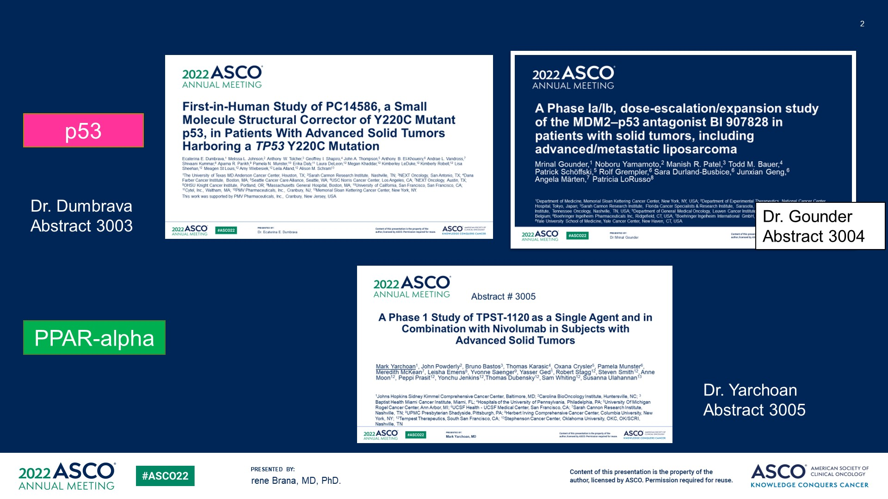
Slide 2
Content of this presentation is the property of the author, licensed by ASCO. Permission required for reuse.

Slide 4
Slide 3
Content of this presentation is the property of the author, licensed by ASCO. Permission required for reuse.

Slide 5
Slide 4
Content of this presentation is the property of the author, licensed by ASCO. Permission required for reuse.

Slide 6
Challenges targeting p53
Content of this presentation is the property of the author, licensed by ASCO. Permission required for reuse.

Slide 7
TP53 wild type vs TP53 mutant
Content of this presentation is the property of the author, licensed by ASCO. Permission required for reuse.

Slide 8
Challenges targeting wild-type p53
Content of this presentation is the property of the author, licensed by ASCO. Permission required for reuse.

Slide 9
Challenges targeting mutant p53
Content of this presentation is the property of the author, licensed by ASCO. Permission required for reuse.

Slide 10
Fatty Acid Oxidation and PPAR-alpha
Content of this presentation is the property of the author, licensed by ASCO. Permission required for reuse.

Slide 11
Fatty Acid Oxidation and PPAR-alpha
Content of this presentation is the property of the author, licensed by ASCO. Permission required for reuse.

Slide 12
Relevance of the target - Patient selection strategy
Content of this presentation is the property of the author, licensed by ASCO. Permission required for reuse.

Slide 13
Slide 12
Content of this presentation is the property of the author, licensed by ASCO. Permission required for reuse.

Slide 14
Slide 14
Content of this presentation is the property of the author, licensed by ASCO. Permission required for reuse.

Slide 15
PC14586: single agent dose escalation
Content of this presentation is the property of the author, licensed by ASCO. Permission required for reuse.

Slide 16
BI 907828: <br />Well differentiated liposarcoma and dedifferentiated liposarcoma cohorts
Content of this presentation is the property of the author, licensed by ASCO. Permission required for reuse.

Slide 17
TPST-1120: dose escalation<br />single agent and combination with nivolumab
Content of this presentation is the property of the author, licensed by ASCO. Permission required for reuse.

Slide 18
Slide 18
Content of this presentation is the property of the author, licensed by ASCO. Permission required for reuse.

Slide 19
PC14586 – well tolerated
Content of this presentation is the property of the author, licensed by ASCO. Permission required for reuse.

Slide 20
BI 907828: several discontinuations due to AE
Content of this presentation is the property of the author, licensed by ASCO. Permission required for reuse.

Slide 21
Slide 21
Content of this presentation is the property of the author, licensed by ASCO. Permission required for reuse.

Slide 22
Slide 22
Content of this presentation is the property of the author, licensed by ASCO. Permission required for reuse.

Slide 23
PC14586: <br />antitumor activity across tumor types
Content of this presentation is the property of the author, licensed by ASCO. Permission required for reuse.

Slide 24
Slide 24
Content of this presentation is the property of the author, licensed by ASCO. Permission required for reuse.

Slide 25
TPST-1120
Content of this presentation is the property of the author, licensed by ASCO. Permission required for reuse.

Slide 26
Slide 26
Content of this presentation is the property of the author, licensed by ASCO. Permission required for reuse.

Slide 27
Slide 28
Content of this presentation is the property of the author, licensed by ASCO. Permission required for reuse.

Slide 28
Slide 29
Content of this presentation is the property of the author, licensed by ASCO. Permission required for reuse.

Slide 29
Summary
Content of this presentation is the property of the author, licensed by ASCO. Permission required for reuse.

Slide 30
Have the authors proved to drug the undruggable?
Content of this presentation is the property of the author, licensed by ASCO. Permission required for reuse.

Slide 31
谢谢

