Slide 1
胰腺癌的整合治疗
福建省肿瘤医院 腹部肿瘤内科

Slide 2
Randomized phase III trial of induction chemotherapy followed by chemoradiotherapy or chemotherapy alone for non-resectable locally advanced pancreatic cancer: First results of the CONKO-007 trial
Content of this presentation is the property of the author, licensed by ASCO. Permission required for reuse.

Slide 3
Disclosure Information: Rainer Fietkau
Content of this presentation is the property of the author, licensed by ASCO. Permission required for reuse.

Slide 4
Randomized phase III trial of induction chemotherapy followed by chemoradiotherapy or chemotherapy alone for non-resectable locally advanced pancreatic cancer: First results of the CONKO-007 trial<br />Study design Background
Content of this presentation is the property of the author, licensed by ASCO. Permission required for reuse.

Slide 5
Randomized phase III trial of induction chemotherapy followed by chemoradiotherapy or chemotherapy alone for non-resectable locally advanced pancreatic cancer: First results of the CONKO-007 trial<br />Study design
Content of this presentation is the property of the author, licensed by ASCO. Permission required for reuse.

Slide 6
Randomized phase III trial of induction chemotherapy followed by chemoradiotherapy or chemotherapy alone for non-resectable locally advanced pancreatic cancer: First results of the CONKO-007 trial<br /><br />Consort diagram
Content of this presentation is the property of the author, licensed by ASCO. Permission required for reuse.

Slide 7
Randomized phase III trial of induction chemotherapy followed by chemoradiotherapy or chemotherapy alone for non-resectable locally advanced pancreatic cancer: First results of the CONKO-007 trial<br /><br />Patient characteristics Occurence of toxicities after randomization (grade 3 & 4) <br />
Content of this presentation is the property of the author, licensed by ASCO. Permission required for reuse.

Slide 8
Randomized phase III trial of induction chemotherapy followed by chemoradiotherapy or chemotherapy alone for non-resectable locally advanced pancreatic cancer: First results of the CONKO-007 trial<br /><br />Resection Data I:<br />compared to all patients with resection (60/62) definition of CRM status<br />
Content of this presentation is the property of the author, licensed by ASCO. Permission required for reuse.

Slide 9
Randomized phase III trial of induction chemotherapy followed by chemoradiotherapy or chemotherapy alone for non-resectable locally advanced pancreatic cancer: First results of the CONKO-007 trial<br /><br />Resection Data II:<br />compared to all randomized patients (167/169) definition of CRM status<br />
Content of this presentation is the property of the author, licensed by ASCO. Permission required for reuse.

Slide 10
Randomized phase III trial of induction chemotherapy followed by chemoradiotherapy or chemotherapy alone for non-resectable locally advanced pancreatic cancer: First results of the CONKO-007 trial<br />PFS CT versus CRT Overall Survival CT versus CRT <br />(randomized pts; T=0 date of randomization) (randomized pts; T=0 date of randomization)
Content of this presentation is the property of the author, licensed by ASCO. Permission required for reuse.

Slide 11
Randomized phase III trial of induction chemotherapy followed by chemoradiotherapy or chemotherapy alone for non-resectable locally advanced pancreatic cancer: First results of the CONKO-007 trial<br /> <br /> Overall survival of all 336 randomized patients with/without surgery <br /> (T=0 date of randomization)
Content of this presentation is the property of the author, licensed by ASCO. Permission required for reuse.

Slide 12
Randomized phase III trial of induction chemotherapy followed by chemoradiotherapy or chemotherapy alone for non-resectable locally advanced pancreatic cancer: First results of the CONKO-007 trial<br /><br />Overall survival (OS) divided by resection status (T=0: date of signed ICF)<br />CRM - versus CRM + resection status R0 versus R1 resection status <br /><br /><br />
Content of this presentation is the property of the author, licensed by ASCO. Permission required for reuse.

Slide 13
Randomized phase III trial of induction chemotherapy followed by chemoradiotherapy or chemotherapy alone for non-resectable locally advanced pancreatic cancer: First results of the CONKO-007 trial<br /><br />Subgroup-analysis of all surgically treated patients (N = 122) Subgroup analysis of all surgical patients treated with FOLFIRINOX (N = 112)<br />Overall survival in randomized patients with surgery Overall survival in randomized patients with surgery comparing CT<br />comparing CT (N = 60) and CTR (N = 62) (N = 56) versus CRT (N = 56)
Content of this presentation is the property of the author, licensed by ASCO. Permission required for reuse.

Slide 14
Randomized phase III trial of induction chemotherapy followed by chemoradiotherapy or chemotherapy alone for non-resectable locally advanced pancreatic cancer: First results of the CONKO-007 trial<br /><br />Conclusions
Content of this presentation is the property of the author, licensed by ASCO. Permission required for reuse.

Slide 15
We would like to thank all patients and their relatives for participation as well as all PIs and study nurses for their support and the German cancer aid for funding
Content of this presentation is the property of the author, licensed by ASCO. Permission required for reuse.

Slide 16
Randomized phase III trial of induction chemotherapy followed by chemoradiotherapy or chemotherapy alone for non-resectable locally advanced pancreatic cancer: First results of the CONKO-007 trial<br /> <br />Literature
Content of this presentation is the property of the author, licensed by ASCO. Permission required for reuse.

Slide 17
Sequential nab-paclitaxel/gemcitabine followed by modified FOLFOX, for first-line metastatic pancreatic ductal carcinoma (mPDAC): the SEQUENCE trial
Content of this presentation is the property of the author, licensed by ASCO. Permission required for reuse.

Slide 18
Author Disclosures
Content of this presentation is the property of the author, licensed by ASCO. Permission required for reuse.

Slide 19
Rationale
Content of this presentation is the property of the author, licensed by ASCO. Permission required for reuse.

Slide 20
SEQUENCE trial: Study Design
Content of this presentation is the property of the author, licensed by ASCO. Permission required for reuse.

Slide 21
Statistical Design
Content of this presentation is the property of the author, licensed by ASCO. Permission required for reuse.

Slide 22
Consort flow diagram
Content of this presentation is the property of the author, licensed by ASCO. Permission required for reuse.

Slide 23
Patient Characteristics
Content of this presentation is the property of the author, licensed by ASCO. Permission required for reuse.

Slide 24
Safety analysis
Content of this presentation is the property of the author, licensed by ASCO. Permission required for reuse.

Slide 25
Slide 9
Content of this presentation is the property of the author, licensed by ASCO. Permission required for reuse.

Slide 26
Time to progression by treatment arm
Content of this presentation is the property of the author, licensed by ASCO. Permission required for reuse.

Slide 27
Progression-free survival by treatment arm
Content of this presentation is the property of the author, licensed by ASCO. Permission required for reuse.

Slide 28
Overall survival by treatment arm
Content of this presentation is the property of the author, licensed by ASCO. Permission required for reuse.

Slide 29
Primary endpoint: 12-month OS rate
Content of this presentation is the property of the author, licensed by ASCO. Permission required for reuse.

Slide 30
Treatment exposure
Content of this presentation is the property of the author, licensed by ASCO. Permission required for reuse.

Slide 31
Treatment exposure
Content of this presentation is the property of the author, licensed by ASCO. Permission required for reuse.

Slide 32
Subsequent PDAC treatments
Content of this presentation is the property of the author, licensed by ASCO. Permission required for reuse.

Slide 33
Quality of life
Content of this presentation is the property of the author, licensed by ASCO. Permission required for reuse.

Slide 34
Conclusions
Content of this presentation is the property of the author, licensed by ASCO. Permission required for reuse.

Slide 35
Acknowledgements
Content of this presentation is the property of the author, licensed by ASCO. Permission required for reuse.

Slide 36
INTEGRATION OF CARE IN PANCREATIC CANCER
Content of this presentation is the property of the author, licensed by ASCO. Permission required for reuse.

Slide 37
CONKO-007
Content of this presentation is the property of the author, licensed by ASCO. Permission required for reuse.

Slide 38
Slide 10
Content of this presentation is the property of the author, licensed by ASCO. Permission required for reuse.

Slide 39
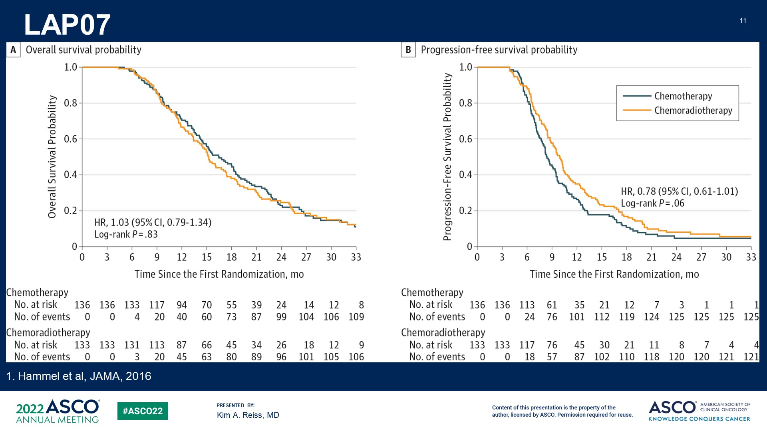
LAP07
Content of this presentation is the property of the author, licensed by ASCO. Permission required for reuse.

Slide 40
CONKO-007
Content of this presentation is the property of the author, licensed by ASCO. Permission required for reuse.

Slide 41
CONKO-007
Content of this presentation is the property of the author, licensed by ASCO. Permission required for reuse.

Slide 42
CONKO-007
Content of this presentation is the property of the author, licensed by ASCO. Permission required for reuse.

Slide 43
CONKO-007: BOTTOM LINES
Content of this presentation is the property of the author, licensed by ASCO. Permission required for reuse.

Slide 44
Slide 16
Content of this presentation is the property of the author, licensed by ASCO. Permission required for reuse.

Slide 45
SEQUENCE: KEY QUESTIONS
Content of this presentation is the property of the author, licensed by ASCO. Permission required for reuse.

Slide 46
Who are the patients? How do they compare to the populations who are typically given mFOLFIRINOX vs gemcitabine/nab-paclitaxel in practice?<br />
Content of this presentation is the property of the author, licensed by ASCO. Permission required for reuse.

Slide 47
How does this regimen compare to front-line FOLFIRINOX from a toxicity and efficacy standpoint?<br />
Content of this presentation is the property of the author, licensed by ASCO. Permission required for reuse.

Slide 48
Slide 20
Content of this presentation is the property of the author, licensed by ASCO. Permission required for reuse.

Slide 49
SEQUENCE: BOTTOM LINES
Content of this presentation is the property of the author, licensed by ASCO. Permission required for reuse.

Slide 50
ACKNOWLEDGMENTS
Content of this presentation is the property of the author, licensed by ASCO. Permission required for reuse.

Slide 51
感谢聆听！

