Slide 1
PD-1 blockade as curative-intent therapy in mismatch repair deficient locally advanced rectal cancer
Content of this presentation is the property of the author, licensed by ASCO. Permission required for reuse.

Slide 2
Slide 2
Content of this presentation is the property of the author, licensed by ASCO. Permission required for reuse.

Slide 3
Slide 3
Content of this presentation is the property of the author, licensed by ASCO. Permission required for reuse.

Slide 4
Hypothesis:<br /><br />In mismatch repair deficient rectal cancer, PD-1 blockade may be able to either:<br /><br /> a) replace chemotherapy <br /><br /> b) replace chemo and radiation therapy<br /><br /> c) replace chemo and radiation, and surgery
Content of this presentation is the property of the author, licensed by ASCO. Permission required for reuse.

Slide 5
Slide 5
Content of this presentation is the property of the author, licensed by ASCO. Permission required for reuse.

Slide 6
Slide 6
Content of this presentation is the property of the author, licensed by ASCO. Permission required for reuse.

Slide 7
Slide 7
Content of this presentation is the property of the author, licensed by ASCO. Permission required for reuse.

Slide 8
Slide 8
Content of this presentation is the property of the author, licensed by ASCO. Permission required for reuse.

Slide 9
Slide 9
Content of this presentation is the property of the author, licensed by ASCO. Permission required for reuse.

Slide 10
Slide 10
Content of this presentation is the property of the author, licensed by ASCO. Permission required for reuse.

Slide 11
Slide 11
Content of this presentation is the property of the author, licensed by ASCO. Permission required for reuse.

Slide 12
Slide 12
Content of this presentation is the property of the author, licensed by ASCO. Permission required for reuse.

Slide 13
Slide 13
Content of this presentation is the property of the author, licensed by ASCO. Permission required for reuse.

Slide 14
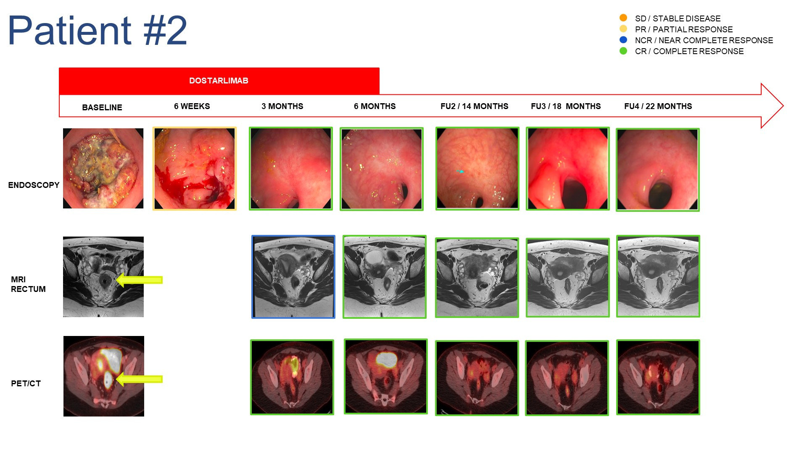
Slide 14
Content of this presentation is the property of the author, licensed by ASCO. Permission required for reuse.

Slide 15
Slide 15
Content of this presentation is the property of the author, licensed by ASCO. Permission required for reuse.

Slide 16
Slide 16
Content of this presentation is the property of the author, licensed by ASCO. Permission required for reuse.

Slide 17
Slide 17
Content of this presentation is the property of the author, licensed by ASCO. Permission required for reuse.

Slide 18
Slide 18
Content of this presentation is the property of the author, licensed by ASCO. Permission required for reuse.

Slide 19
Key Observations
Content of this presentation is the property of the author, licensed by ASCO. Permission required for reuse.

Slide 20
Conclusion
Content of this presentation is the property of the author, licensed by ASCO. Permission required for reuse.

Slide 21
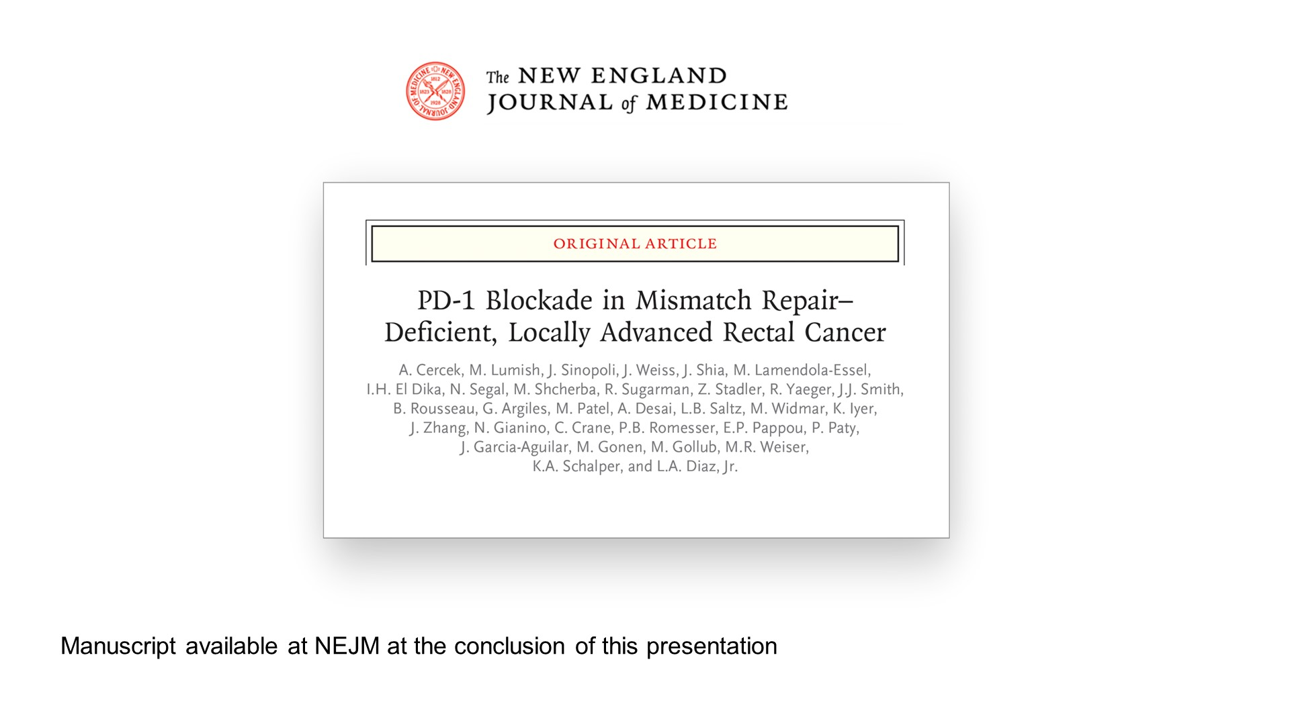
Slide 21
Content of this presentation is the property of the author, licensed by ASCO. Permission required for reuse.

Slide 22
Slide 22
Content of this presentation is the property of the author, licensed by ASCO. Permission required for reuse.

Slide 23
Slide 23
Content of this presentation is the property of the author, licensed by ASCO. Permission required for reuse.

Slide 24
Slide 24
Content of this presentation is the property of the author, licensed by ASCO. Permission required for reuse.

