Slide 1
Overcoming Emerging Drug Resistance in Intrahepatic Cholangiocarcinoma

Slide 2
TKI Resistance: Overview
Content of this presentation is the property of the author, licensed by ASCO. Permission required for reuse.

Slide 3
Mechanisms of Resistance to TKI
Content of this presentation is the property of the author, licensed by ASCO. Permission required for reuse.

Slide 4
Content of this presentation is the property of the author, licensed by ASCO. Permission required for reuse.

Slide 5
FGFR Inhibitors <br />FGFR2 Fusion–Positive Cholangiocarcinoma1-9
Content of this presentation is the property of the author, licensed by ASCO. Permission required for reuse.

Slide 6
01 | Derazantinib in FGFR2MT/AMP iCCA patients<br />Duration of treatment / response* (secondary endpoint)
Content of this presentation is the property of the author, licensed by ASCO. Permission required for reuse.

Slide 7
Innate Resistance: Case History
Content of this presentation is the property of the author, licensed by ASCO. Permission required for reuse.

Slide 8
FGFR CCA: Concurrent Mutation and Prognosis
Content of this presentation is the property of the author, licensed by ASCO. Permission required for reuse.

Slide 9
Futibatinib Activity: Co-occurring Genomic Alterationsa
Content of this presentation is the property of the author, licensed by ASCO. Permission required for reuse.

Slide 10
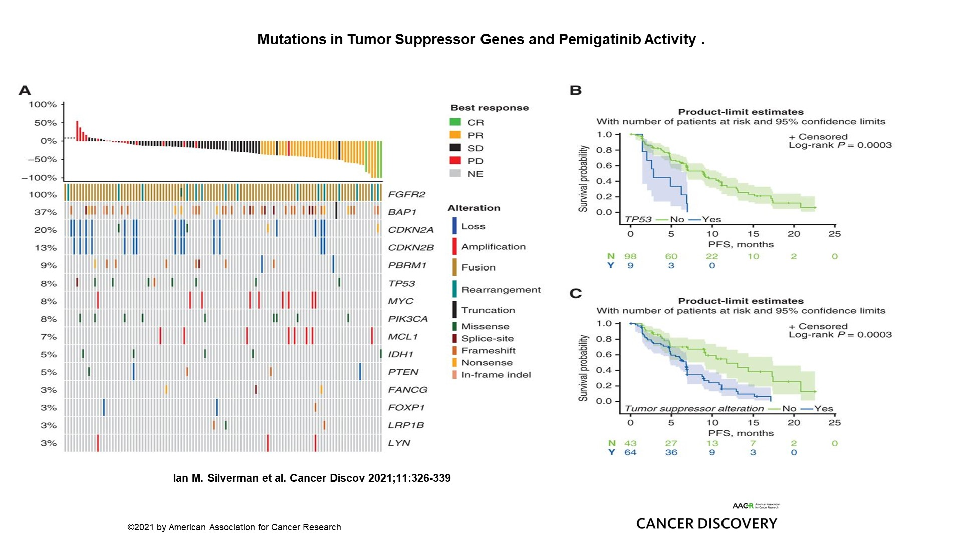
Slide 10
Content of this presentation is the property of the author, licensed by ASCO. Permission required for reuse.

Slide 11
Slide 11
Content of this presentation is the property of the author, licensed by ASCO. Permission required for reuse.

Slide 12
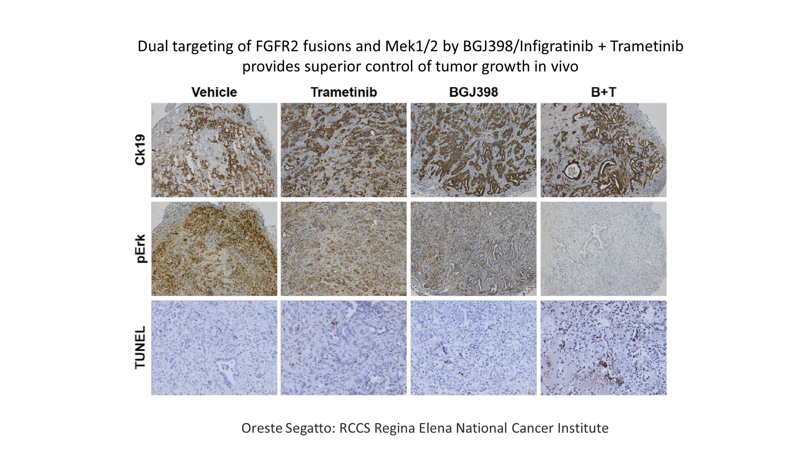
Slide 12
Content of this presentation is the property of the author, licensed by ASCO. Permission required for reuse.

Slide 13
IDH Alterations Associated with Immunosuppressed TME
Content of this presentation is the property of the author, licensed by ASCO. Permission required for reuse.

Slide 14
Mutant IDH: Immune evasion and resistance
Content of this presentation is the property of the author, licensed by ASCO. Permission required for reuse.

Slide 15
Slide 15
Content of this presentation is the property of the author, licensed by ASCO. Permission required for reuse.

Slide 16
Innate Resistance to TKI in CCA
Content of this presentation is the property of the author, licensed by ASCO. Permission required for reuse.

Slide 17
Acquired Resistance to FGFR Inhibitors
Content of this presentation is the property of the author, licensed by ASCO. Permission required for reuse.

Slide 18
Slide 18
Content of this presentation is the property of the author, licensed by ASCO. Permission required for reuse.

Slide 19
Futibatinib: Selective Covalent FGFR1–4 Inhibitor
Content of this presentation is the property of the author, licensed by ASCO. Permission required for reuse.

Slide 20
Activity of Futibatinib in Patients with Prior FGFRi
Content of this presentation is the property of the author, licensed by ASCO. Permission required for reuse.

Slide 21
RLY-4008 FIH Study: RLY-4008 induces radiographic tumor regression across FGFR2 alterations
Content of this presentation is the property of the author, licensed by ASCO. Permission required for reuse.

Slide 22
RLY-4008:FGFR2 oncogenic mutations and in FGFR2 amplifications
Content of this presentation is the property of the author, licensed by ASCO. Permission required for reuse.

Slide 23
Slide 23
Content of this presentation is the property of the author, licensed by ASCO. Permission required for reuse.

Slide 24
Slide 24
Content of this presentation is the property of the author, licensed by ASCO. Permission required for reuse.

Slide 25
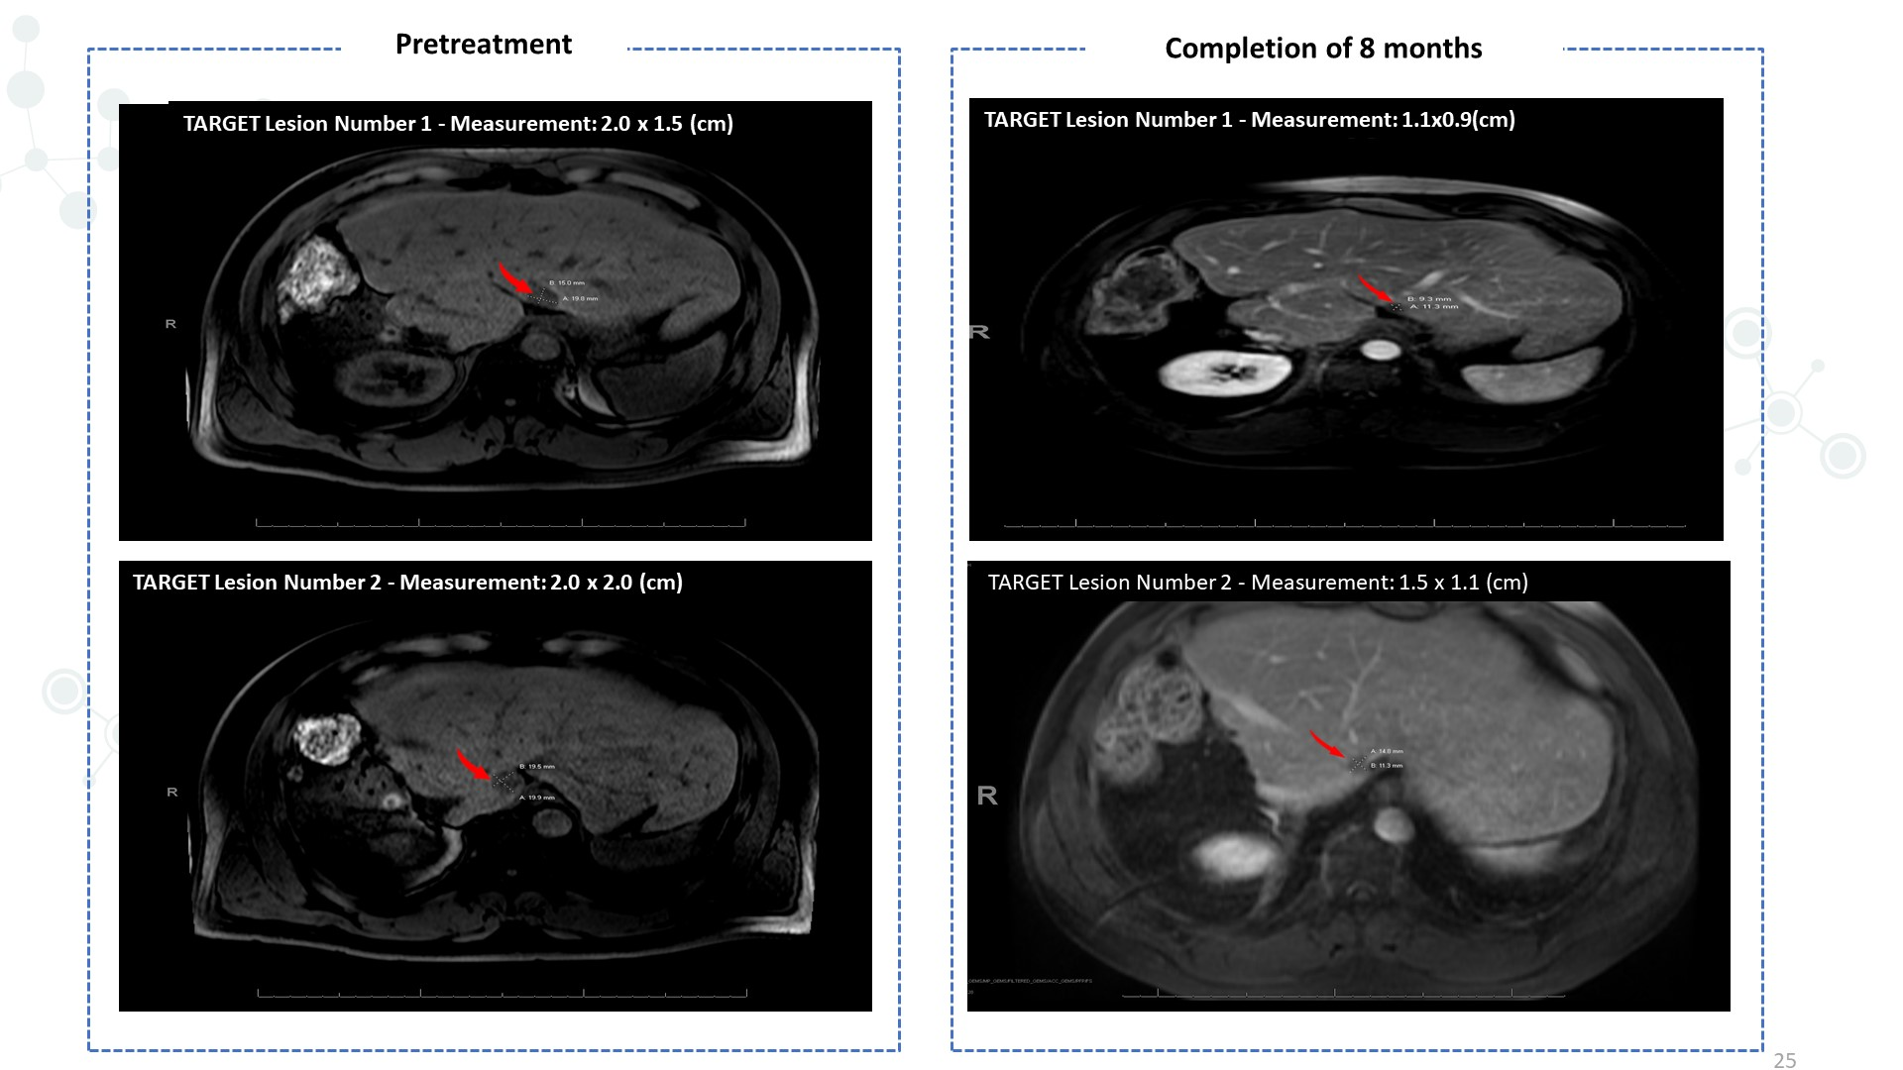
Slide 25
Content of this presentation is the property of the author, licensed by ASCO. Permission required for reuse.

Slide 26
Slide 26
Content of this presentation is the property of the author, licensed by ASCO. Permission required for reuse.

Slide 27
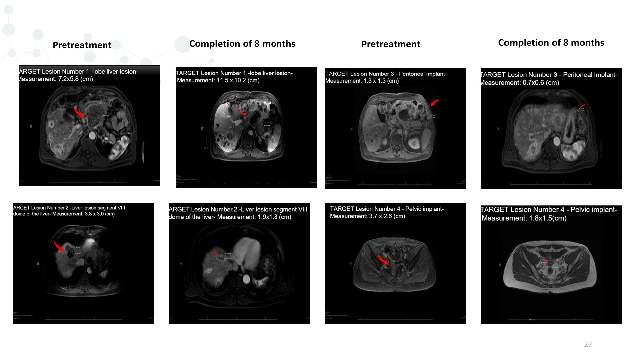
Slide 27
Content of this presentation is the property of the author, licensed by ASCO. Permission required for reuse.

Slide 28
Slide 28
Content of this presentation is the property of the author, licensed by ASCO. Permission required for reuse.

Slide 29
Content of this presentation is the property of the author, licensed by ASCO. Permission required for reuse.

Slide 30
IDH Mutations in Intrahepatic Cholangiocarcinoma
Content of this presentation is the property of the author, licensed by ASCO. Permission required for reuse.

Slide 31
<br />Phase 3 ClarIDHy trial: IDH1 inhibitor ivosidenib vs placebo in second-line setting: PFS by IRC
Content of this presentation is the property of the author, licensed by ASCO. Permission required for reuse.

Slide 32
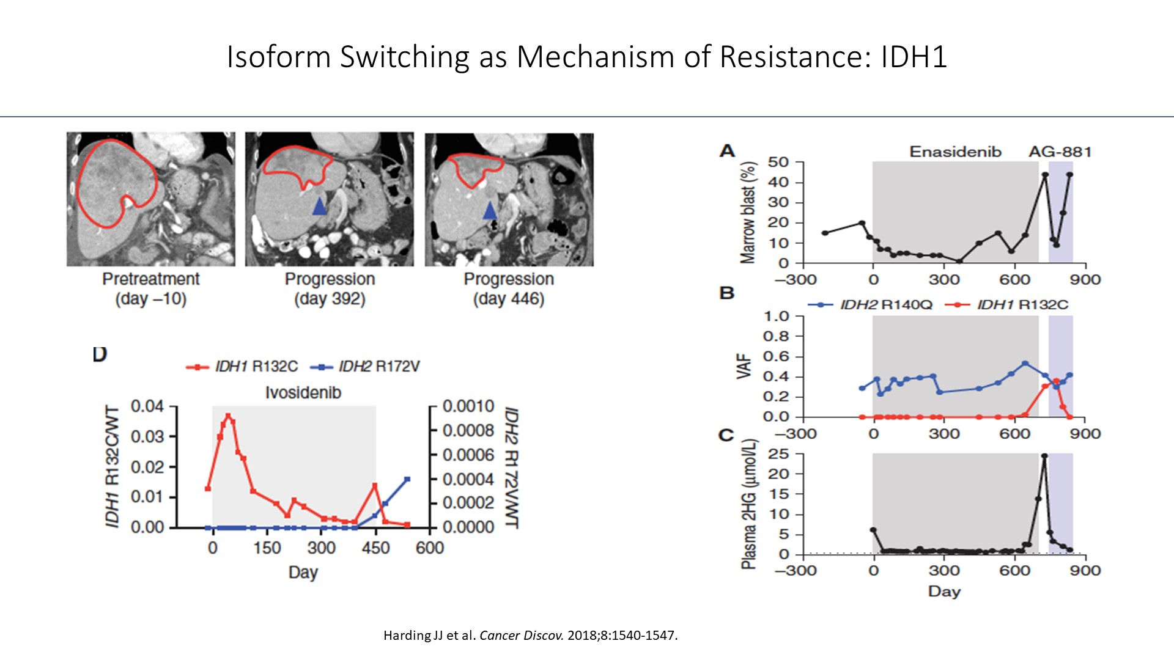
Isoform Switching as Mechanism of Resistance: IDH1
Content of this presentation is the property of the author, licensed by ASCO. Permission required for reuse.

Slide 33
Conclusions
Content of this presentation is the property of the author, licensed by ASCO. Permission required for reuse.

Slide 34
Content of this presentation is the property of the author, licensed by ASCO. Permission required for reuse
PPT素材来自ASCO，仅用于学习交流，请勿截屏外传，谢谢！

