Slide 1
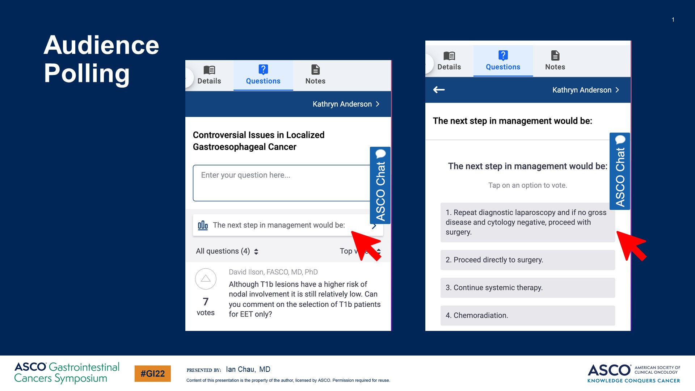
Audience <br />Polling
Content of this presentation is the property of the author, licensed by ASCO. Permission required for reuse.

Slide 2
Current landscape of checkpoint inhibitors in advanced gastroesophageal cancer
Content of this presentation is the property of the author, licensed by ASCO. Permission required for reuse.

Slide 3
Continuum of care in advanced gastric cancer
Content of this presentation is the property of the author, licensed by ASCO. Permission required for reuse.

Slide 4
Randomised first line phase III nivolumab study in gastric and GEJ adenocarcinoma (CHECKMATE-649)
Content of this presentation is the property of the author, licensed by ASCO. Permission required for reuse.

Slide 5
CHECKMATE-649: overall survival (PD-L1 CPS ≥5)
Content of this presentation is the property of the author, licensed by ASCO. Permission required for reuse.

Slide 6
CHECKMATE-649 Updated analysis Overall survival: NIVO + chemo vs chemo
Content of this presentation is the property of the author, licensed by ASCO. Permission required for reuse.

Slide 7
CHECKMATE 649: Updated analysis Progression-free survival: NIVO + chemo vs chemo
Content of this presentation is the property of the author, licensed by ASCO. Permission required for reuse.

Slide 8
Worldwide differences in approval
Content of this presentation is the property of the author, licensed by ASCO. Permission required for reuse.

Slide 9
ORIENT 16: Chemo ± sintilimab in 1st line treatment of advanced gastric adenocarcinoma
Content of this presentation is the property of the author, licensed by ASCO. Permission required for reuse.

Slide 10
ORIENT 16: Chemo ± sintilimab in 1st line treatment of advanced gastric adenocarcinoma
Content of this presentation is the property of the author, licensed by ASCO. Permission required for reuse.

Slide 11
Randomised first line phase III nivolumab study in gastric and GEJ adenocarcinoma (ATTRACTION 4)
Content of this presentation is the property of the author, licensed by ASCO. Permission required for reuse.

Slide 12
ATTRACTION 4: PFS
Content of this presentation is the property of the author, licensed by ASCO. Permission required for reuse.

Slide 13
ATTRACTION 4: OS and ORR
Content of this presentation is the property of the author, licensed by ASCO. Permission required for reuse.

Slide 14
Randomised first line phase III pembrolizumab study in gastric and GEJ adenocarcinoma (KEYNOTE-062)
Content of this presentation is the property of the author, licensed by ASCO. Permission required for reuse.

Slide 15
Chemo + pembrolizumab did not improve survival in gastric cancer
Content of this presentation is the property of the author, licensed by ASCO. Permission required for reuse.

Slide 16
Randomised first line phase III pembrolizumab study in oesophageal cancer (SCC and adenocarcinoma): KEYNOTE 590
Content of this presentation is the property of the author, licensed by ASCO. Permission required for reuse.

Slide 17
KEYNOTE 590: Baseline characteristics
Content of this presentation is the property of the author, licensed by ASCO. Permission required for reuse.

Slide 18
KEYNOTE 590: efficacy in oesophageal and OGJ adenocarcinoma
Content of this presentation is the property of the author, licensed by ASCO. Permission required for reuse.

Slide 19
KEYNOTE 590: Survival in Key Subgroups: All Patients
Content of this presentation is the property of the author, licensed by ASCO. Permission required for reuse.

Slide 20
KEYNOTE 590: Survival in Key Subgroups: All Patients
Content of this presentation is the property of the author, licensed by ASCO. Permission required for reuse.

Slide 21
Worldwide differences in approval
Content of this presentation is the property of the author, licensed by ASCO. Permission required for reuse.

Slide 22
Continuum of care in advanced gastric cancer
Content of this presentation is the property of the author, licensed by ASCO. Permission required for reuse.

Slide 23
Trastuzumab, chemo + pembrolizumab in HER2 +ve gastric cancer<br />
Content of this presentation is the property of the author, licensed by ASCO. Permission required for reuse.

Slide 24
The Cancer Genome Atlas oesophago-gastric cancer
Content of this presentation is the property of the author, licensed by ASCO. Permission required for reuse.

Slide 25
RMH metastatic SCC vs. adenocarcinoma pooled analysis from 3 RCTs (n=973)
Content of this presentation is the property of the author, licensed by ASCO. Permission required for reuse.

Slide 26
PD-1 Inhibitors in previously treated oesophageal cancer
Content of this presentation is the property of the author, licensed by ASCO. Permission required for reuse.

Slide 27
Consistent survival efficacy of PD-1 inhibitors in previously treated oesophageal cancer
Content of this presentation is the property of the author, licensed by ASCO. Permission required for reuse.

Slide 28
Randomised first line phase III pembrolizumab study in oesophageal cancer (SCC and adenocarcinoma): KEYNOTE 590
Content of this presentation is the property of the author, licensed by ASCO. Permission required for reuse.

Slide 29
KEYNOTE 590: Chemo + IO in 1st line treatment of advanced SCC oesophagus
Content of this presentation is the property of the author, licensed by ASCO. Permission required for reuse.

Slide 30
CHECKMATE 648: Nivolumab + chemo, nivolumab + ipilimumab vs. chemo in 1L Oesophageal SCC
Content of this presentation is the property of the author, licensed by ASCO. Permission required for reuse.

Slide 31
Chemo + IO in 1st line treatment of advanced SCC oesophagus
Content of this presentation is the property of the author, licensed by ASCO. Permission required for reuse.

Slide 32
Chemo + IO in 1st line treatment of advanced SCC oesophagus
Content of this presentation is the property of the author, licensed by ASCO. Permission required for reuse.

Slide 33
Consistent survival efficacy of Chemo plus PD-1 inhibitors in 1L ESCC
Content of this presentation is the property of the author, licensed by ASCO. Permission required for reuse.

Slide 34
CHECKMATE 648 Overall survival: NIVO + IPI vs chemo
Content of this presentation is the property of the author, licensed by ASCO. Permission required for reuse.

Slide 35
Treatment paradigm in advanced/ metastatic <br />SCC oesophagus 2021
Content of this presentation is the property of the author, licensed by ASCO. Permission required for reuse.

Slide 36
PD-L1 Diagnostic Assays: Mess or Harmony
Content of this presentation is the property of the author, licensed by ASCO. Permission required for reuse.

Slide 37
Comparison of PD-L1 expression between 22C3 and 28-8 pharmDx assays interchangeability
Content of this presentation is the property of the author, licensed by ASCO. Permission required for reuse.

Slide 38
Comparison of PD-L1 expression between 22C3 and 28-8 pharmDx assays interchangeability*
Content of this presentation is the property of the author, licensed by ASCO. Permission required for reuse.

Slide 39
Acknowledgement
Content of this presentation is the property of the author, licensed by ASCO. Permission required for reuse.

Slide 40
Slide 40
Content of this presentation is the property of the author, licensed by ASCO. Permission required for reuse.

