Slide 1
Session: Checkpoint Inhibitor–Based Therapies: New Immuno-Oncology Targets and Resistance Mechanisms<br /><br />Resistant Mechanisms and Combinations Partners: What Is New?
Content of this presentation is the property of the author, licensed by ASCO. Permission required for reuse.

Slide 2
Disclosures of Relevant Relations with Industry
Content of this presentation is the property of the author, licensed by ASCO. Permission required for reuse.

Slide 3
Acquired resistance to immune checkpoint blockade therapy, Keynote 006 trial
Content of this presentation is the property of the author, licensed by ASCO. Permission required for reuse.

Slide 4
Genetic Mechanisms of Acquired Resistance in Patient Biopsies
Content of this presentation is the property of the author, licensed by ASCO. Permission required for reuse.

Slide 5
B2M cn-LOH in resistance to PD-1 blockade therapy
Content of this presentation is the property of the author, licensed by ASCO. Permission required for reuse.

Slide 6
Role of antigen presentation/B2M pathway in acquired resistance
Content of this presentation is the property of the author, licensed by ASCO. Permission required for reuse.

Slide 7
Bempegaldesleukin/NKTR214 reverses resistance in B2M-deficient MC38 mediated by CD4 and NK cells
Content of this presentation is the property of the author, licensed by ASCO. Permission required for reuse.

Slide 8
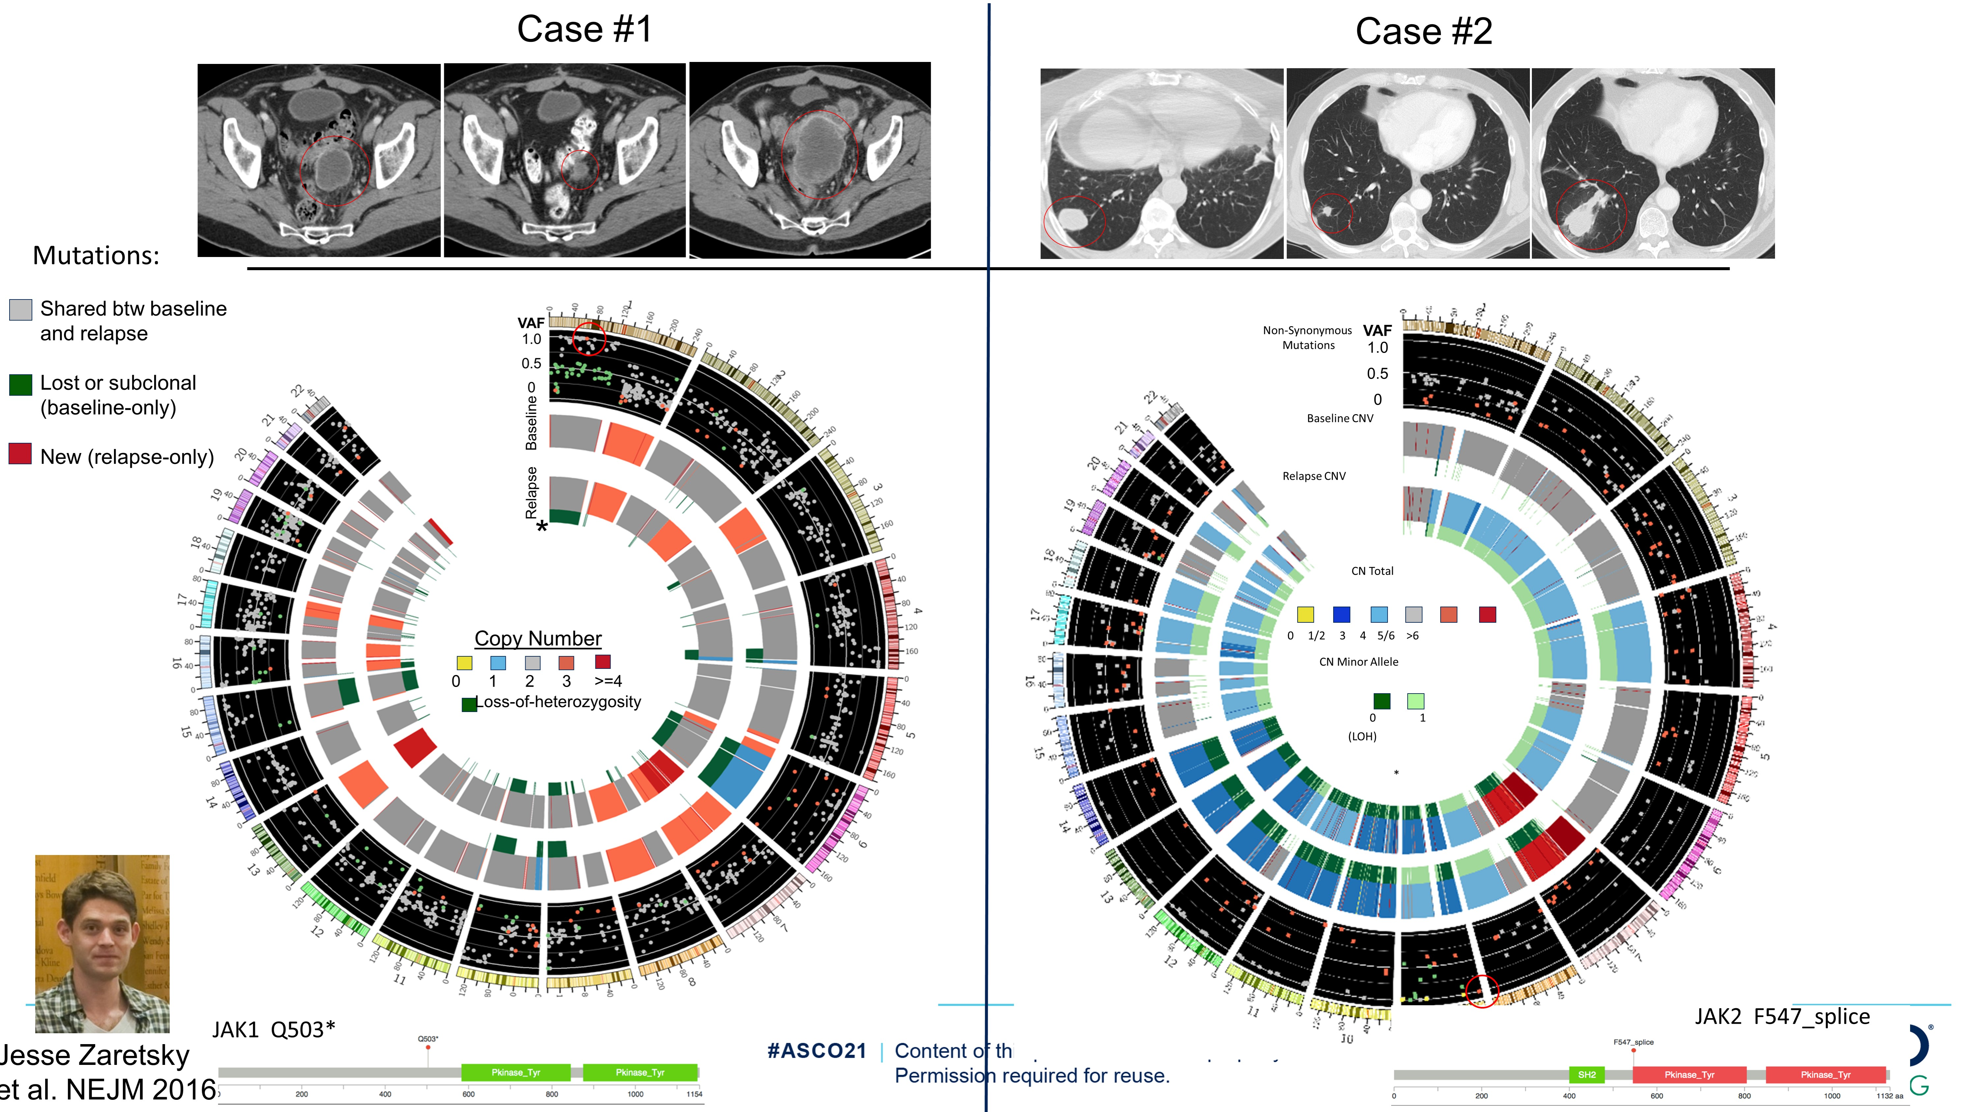
Slide 8
Content of this presentation is the property of the author, licensed by ASCO. Permission required for reuse.

Slide 9
JAK1/2 cn-LOH in resistance to PD-1 blockade therapy
Content of this presentation is the property of the author, licensed by ASCO. Permission required for reuse.

Slide 10
Role of the interferon-gamma receptor signaling pathway in acquired resistance
Content of this presentation is the property of the author, licensed by ASCO. Permission required for reuse.

Slide 11
Overcoming resistance to PD-1 checkpoint blockade by reactivating interferon signaling
Content of this presentation is the property of the author, licensed by ASCO. Permission required for reuse.

Slide 12
Overcoming resistance to anti-PD-1 with intralesional TLR agonist therapy
Content of this presentation is the property of the author, licensed by ASCO. Permission required for reuse.

Slide 13
Intra-tumoral CMP-001 (TLR9 agonist) plus systemic pembrolizumab induces responses in patients anti-PD-1 treated
Content of this presentation is the property of the author, licensed by ASCO. Permission required for reuse.

Slide 14
CD8+ T Cells and Tumor PD-L1 Expression Increased in a Patient With Complete Response
Content of this presentation is the property of the author, licensed by ASCO. Permission required for reuse.

Slide 15
Conclusions
Content of this presentation is the property of the author, licensed by ASCO. Permission required for reuse.

Slide 16
Slide 16
Content of this presentation is the property of the author, licensed by ASCO. Permission required for reuse.

